Slide 1
Types of Fuel Cells

Slide 2
Learning Objectives:
What are the different types of Fuel Cells
What differentiates them from each other
What are their relative advantages and disadvantages

Slide 3
External Load
e⁻
e⁻
e⁻
e⁻
Anode
Cathode
Electrolyte

Slide 4
Ionic conductivity
Vs
Electronic conductivity

Slide 5
Type of fuel cell
PEFC / PEM
Polymer electrolyte fuel cell
AFC
Alkaline fuel cell
PAFC
Phosphoric acid fuel cell
MCFC
Molten carbonate fuel cell
SOFC
Solid oxide fuel cell
Temperature
< 100 ºC
100 - 250 ºC
160 - 220 ºC
600 - 700 ºC
~ 1000 ºC

Slide 6
Anode
Electrolyte
Cathode
PEM
PAFC
O₂
H₂
H⁺
H₂O
H₂
OH⁻
AFC
O₂
H₂O
H₂
CO₃²⁻
O₂
MCFC
H₂O
CO₂
CO₂
H₂
O²⁻
SOFC
O₂
H₂O

Slide 7
H₂
2H⁺ + 2e⁻
PEM
PAFC
½ O₂ + 2H⁺ + 2e⁻
H₂O
H₂ + 2 OH⁻
2H₂O + 2e⁻
AFC
½ O₂ + H₂O + 2e⁻
2 OH⁻
H₂ + CO₃²⁻
2H₂O + CO₂ + 2e⁻
MCFC
CO + CO₃²⁻
2CO₂ + 2e⁻
½ O₂ + CO₂ + 2e⁻
CO₃²⁻
H₂ + O²⁻
2H₂O + 2e⁻
SOFC
CO + O²⁻
CO₂ + 2e⁻
½ O₂ + 2e⁻
O²⁻

Slide 8
Anode
Electrolyte
Cathode
Perflourinated sulfonic acid
Pt
Pt
PEM
PAFC
Phosphoric acid in SiC
Pt
Pt
Metal Oxides
AFC
Ni/Ag
KOH in Asbestos
Alkali Carbonate in LiAlO₃
MCFC
Ni
NiO
Co-ZrO₂
Ni-ZrO₂
Cermet
Y₂O₃ stabilized ZrO₂
Sr doped LaMnO₃
SOFC

Slide 9
Quick startup; easily available auxiliaries;
Water management; susceptible to impurities
PEM
Reliable
Handles CO₂ poorly
AFC
Can operate with a wide range of fuels
High temperature, corrosion, thermal fatigue
MCFC
Can operate with a wide range of fuels
Expensive auxiliary parts; slow startup
SOFC

Slide 10
Focus of most international efforts:
PEM
SOFC
They represent two extremes of the issues faced and are ideally suited for distinctly different applications

Slide 11
Fuel Processing
for PEM Fuel Cells

Slide 12
Learning Objectives:
Why is fuel processing necessary
What are different approaches to fuel processing
What are important issues associated with fuel processing

Slide 13
Schematic of typical Fuel Cell operation
H₂
Fuel Cell
DC power
O₂

Slide 14
Schematic of typical Fuel Cell systems
H₂ /other fuel/ Reformer
Fuel Cell Stack
DC power / Power Conditioner
O₂ / Air
Auxiliaries and Controls

Slide 15
Why ‘Fuel Processing’ ?
Type of fuel cell / availability of fuel
Hydrogen Vs other fuels
Infrastructure

Slide 16
Steam Reforming
Fuel (C_{n}H_{m}O_{p}) + Steam Carbon Oxides + Hydrogen
ΔH > 0
Strongly endothermic
Reactor design limited by heat transfer
Reactors tend to be large and heavy
Typically catalyst required, usually Ni

Slide 17
Partial Oxidation
Fuel (C_{n}H_{m}O_{p}) + Air Carbon Oxides + Hydrogen + Nitrogen
ΔH < 0
Temperature can climb over 1000 ºC
May not require a catalyst

Slide 18
Auto Thermal Reforming
Fuel (C_{n}H_{m}O_{p}) + Air + Steam Carbon Oxides + Hydrogen + Nitrogen
ΔH < 0
Extent of steam reforming limits the maximum temperature attained

Slide 19
Output of Reforming
Is it good enough?

Slide 20
Water Gas Shift Reaction
CO + H₂O CO₂ + H₂
ΔHº = -41.2 kJ mol⁻¹
Catalysts: Fe₃O₄, CuO/ZnO

Slide 21
Selective Oxidation / Preferential Oxidation
2CO + O₂ CO₂
Ruthenium and Rhodium, supported on Alumina, are usually used as catalyst. Cu and ZnO on Alumina also used

Slide 22
Issues with Reforming
System complexity
Presence of carbon monoxide
Response time
Start up and shut down in case of automotive use

Slide 23
Fuel
Steam Reforming/Partial Oxidation/ Auto Thermal Reforming
Water gas shift reaction
Selective Oxidation
Preferential Oxidation
Fuel Cell Anode

Slide 24
System Integration
Case Studies

Slide 25
Schematic of typical Fuel Cell systems
H₂ /other fuel/ Reformer
Fuel Cell Stack
DC power / Power Conditioner
O₂ / Air
Auxiliaries and Controls

Slide 26

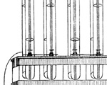
Timeline:
1800 Alessandro Volta
Prof. Of Physics
Univ. of Pavia, Italy
Volta Pile
1839 Sir William Grove
English lawyer
turned scientist
“Gas Battery”
(Fuel Cell)

Slide 27
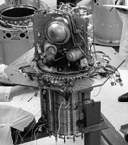
1930s Francis T. Bacon
to Alkali Fuel Cells for Royal Navy
1940s Submarines
1960s Pratt & Whitney
licensed Bacon’s
cell for use in
Apollo Spacecraft

Slide 28
1990s Los Alamos National Laboratory
Dramatic reduction in need for
Pt catalyst
Late
1990s
till
today
Several demonstrations
of “commercial” fuel cells
Homes:
Plug Power, Latham, NY, USA
Automobiles:
Ballard, Vancouver, Canada

Slide 29
Schematic of early design of fuel cell
External
load
Pt electrode
Pt electrode
H₂
O₂
H₂SO₄

Slide 30
Schematic of early design of fuel cell
External
load
Pt electrode
Pt electrode
A
H₂
O₂
H₂SO₄

Slide 31
Improvements in design of fuel cell
“Exploded” view
“Assembled” Side view
H₂
O₂
Thin, perforated
Pt electrode
Porous material soaked in H₂SO₄

Slide 32
Improvements in design of fuel cell
“Exploded” view
“Assembled” Side view
H₂
O₂
Polymer electrolyte material capable of H⁺ transport
Catalyst based
Pt electrode

Slide 33
External Load
e⁻
e⁻
e⁻
e⁻
Anode
Cathode
Polymer Electrolyte

Slide 34
Polymer electrolyte with
catalyst layer on either side
H₂
O₂

Slide 35
Flow field
Gas inlet
Gas outlet
Gas flow
channel
Gas flow
channel

Slide 36
Gas inlet
Gas outlet

Slide 37
Catalyst
layer
Polymer
electrolyte
Gas flow
channel
A
B

Slide 38
Gas diffusion layers (GDLs)

Slide 39
Catalyst
layer
Polymer
electrolyte
Gas flow
channel
A
B
Gas diffusion layer

Slide 40
Cross section of a typical PEM Fuel Cell
Gaskets
Anode Flow
Field
Cathode Flow
Field
Membrane

Slide 41
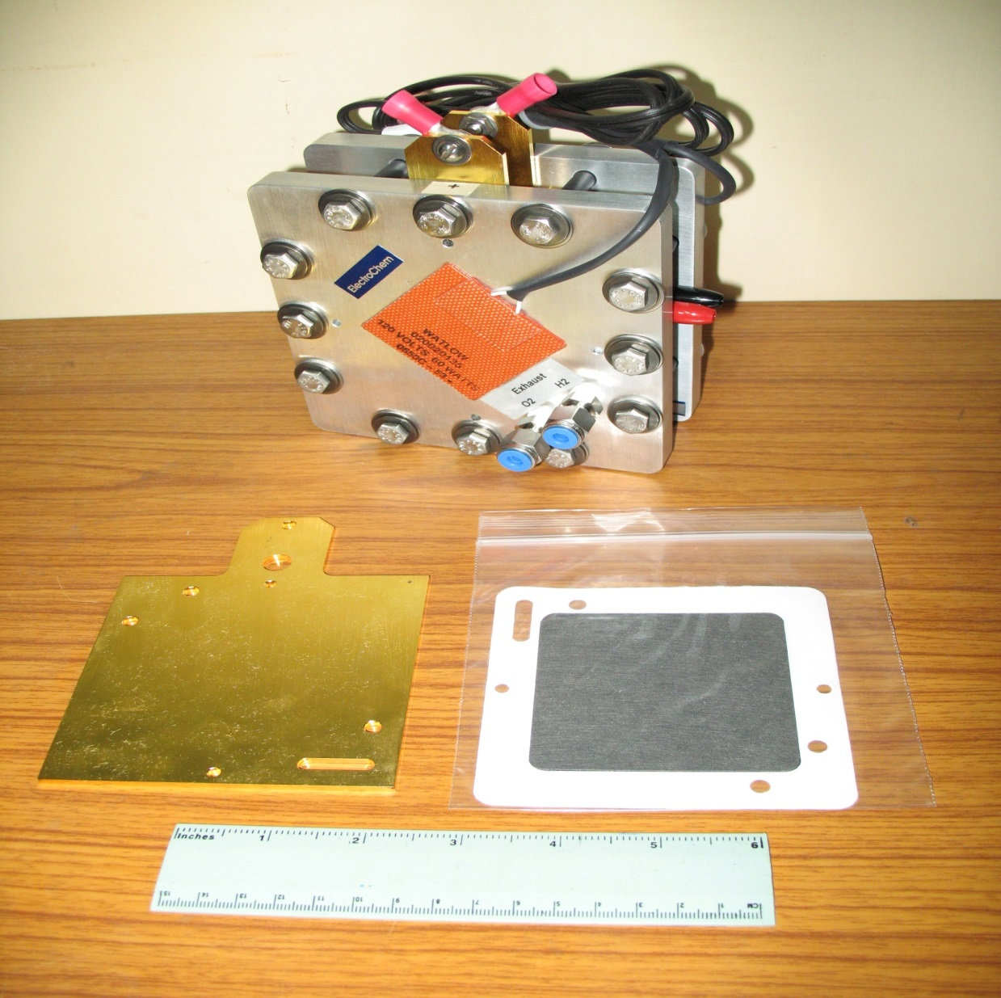

Slide 42
Cross section of a typical PEM Fuel Cell
Membrane

Slide 43
Cross section of a typical PEMC stack
Cathode Flow
Field
Coolant Flow
Channel
Anode Flow
Field

Slide 44
Cross section of a typical PEMC stack
Single Cell
Cathode Flow
Field
Coolant Flow
Channel
Anode Flow
Field

Slide 45
Schematic of polarization curve from a fuel cell
Example:
0.4 A/cm² at 0.5 V
200 cells in series,
each 100cm² in area
can provide 40 A at 100 V (DC)
1.0
Voltage (V)
0.5
0.0
0.0
0.5
1.0
Current density (A/cm²)

Slide 46
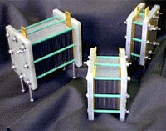
Some commercially available fuel cell stacks

Slide 47
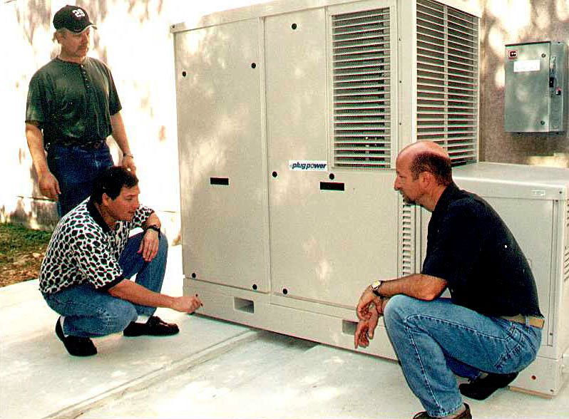

Slide 48


Slide 49
Challenges and Trends

Slide 50
Research Issues
Reformer
Control and Diagnosis
Inverter design
Storage and controlled
release of H₂
Gas diffusion layers (GDLs)
Flow field
Gas
inlet
Gas outlet
Gas flow
channel
Gas flow
channel

Slide 51
Other important design Issues:
Safety!
Hazard from use of pure H₂ and pure O₂
Replacements:
Air for O₂
Natural gas / other fuel that can be reformed to a H₂ rich fuel stream just before use.

Slide 52
Technology Issues
System integration
Robustness
Modularity
Scalability
Locally available fuels
Turndown ratio
Load following capability
Serviceability

Slide 53
Technology Issues
System integration
  Production more than
  consumption
  Mean time between
  failures
  Commercially available
  auxilliaries

Slide 54
Technology Issues
Robustness
Range of operating points
  Temperature
  Pressure
  Humidity

Slide 55
Technology Issues
Modularity
Varying needs of
customers
Focus on a limited
number of products

Slide 56
Technology Issues
Scalability
  Area of cell
  Number of cells

Slide 57
Technology Issues
Locally available fuels
Addressing local
requirements
Acceptability and success
of product

Slide 58
Technology Issues
Turndown ratio
Single product, wide range of uses
User dependant

Slide 59
Controls and Diagnostics
Load following and reformer response time
Critical for practical applications
May be auxiliaries limited
Safety of product
Schematic of Load Profile
Power Demand
Time of day

Slide 60
Technology Issues
Serviceability
Drawback in existing designs
Critical for success of product
Must be addressed in early
stages of development itself

Slide 61
Business Issues
Software model
Auto industry model

